Slide 1
Software Quality Metrics

Slide 2
What to measure
Process
Measure the efficacy of processes. What works, what doesn't.
Project
Assess the status of projects. Track risk. Identify problem areas. Adjust work flow.
Product
Measure predefined product attributes (generally related to ISO9126 Software Characteristics)

Slide 3
Software Quality Metrics
Three kinds of Software Quality Metrics
  Product Metrics - describe the characteristics of product
    size, complexity, design features, performance, and quality level
  Process Metrics - used for improving software development/maintenance process
    effectiveness of defect removal, pattern of testing defect arrival, and response time of fixes
  Project Metrics - describe the project characteristics and execution
    number of developers, cost, schedule, productivity, etc.
    fairly straight forward

Slide 4
The Software Quality Metrics Framework
Quality requirements that the software product must meet
Quality factors – Management-oriented attributes of software that contribute to its quality
Quality subfactors – Decompositions of a quality factor to its technical components
Metrics – quantitative measures of the degree to which given attributes (factors) are present

Slide 5
Measurement, Measures, Metrics
Measurement
  is the act of obtaining a measure
Measure
  provides a quantitative indication of the size of some product or process attribute, E.g., Number of errors
Metric
  is a quantitative measure of the degree to which a system, component, or process possesses a given attribute (IEEE Software Engineering Standards 1993) : Software Quality - E.g., Number of errors found per person hours expended

Slide 6
Software Quality Metrics
Desired attributes of Metrics (Ejiogu, 1991)
  Simple and computable
  Empirical and intuitively persuasive
  Consistent and objective
  Consistent in the use of units and dimensions
  Independent of programming language, so directed at models (analysis, design, test, etc.) or structure of program
  Effective mechanism for quality feedback

Slide 7
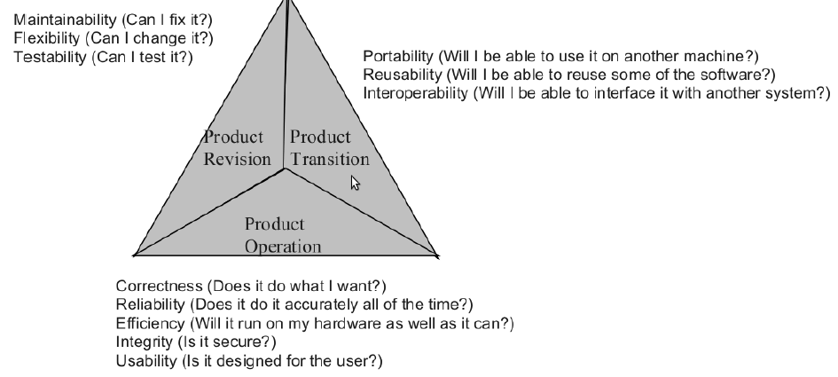
McCall’s Software Quality Factors

Slide 8
Example
Quality requirement – “The product will be easy to use”
Quality factor(s) – Usability (An attribute that bears on the effort needed for use and on the assessment of such use by users)
Quality subfactors – Understandability, ease of learning, operability, communicativeness

Slide 9
Subfactors
Understandability – The amount of effort required to understand software
Ease of learning – The degree to which user effort required to learn how to use the software is minimized
Operability – The degree to which the effort required to perform an operation is minimized
Communicativeness – The degree to which software is designed in accordance with the psychological characteristics of users

Slide 10
Direct Metrics
Understanding
  Learning time: Time for new user to gain basic understanding of features of the software
Ease of learning
  Learning time: Time for new user to learn how to perform basic functions of the software
Operability
  Operation time: Time required for a user to perform operation(s) of the software
Communicativeness
  Human factors: Number of negative comments from new users regarding ergonomics, human factors, etc.

Slide 11
Software Quality Metrics
Correctness:
  defects per KLOC
maintainability
  mean time to change (MTTC) the time it takes to analyze the change request, design an appropriate modification, implement the change, test it, and distribute the change to all users
  spoilage = (cost of change / total cost of system)
integrity
  threat = probability of attack (that causes failure)
  security = probability attack is repelled
  Integrity = Σ [1 - threat * (1 - security)]

Slide 12
Product Metrics
Number and type of defects found during requirements, design, code, and test inspections
Number of pages of documentation delivered
Number of new source lines of code created
Number of source lines of code delivered
Total number or source lines of code delivered
Average complexity of all modules delivered
Average size of modules
Total number of modules
Total number of bugs found as a result of unit testing
Total number of bugs found as a result of integration testing
Total number of bugs found as a result of validation testing
Productivity, as measured by KLOC per person-hour

Slide 13
Product Metrics Landscape
Metrics for the analysis model
Metrics for the design model
Metrics for the source code
Metrics for testing

Slide 14
Metrics for Requirements Quality
E.g., let n_{r} = n_{f} + n_{nf} , where
  n_{r} = number of requirements
  n_{f} = number of functional requirements
  n_{nf} = number of nonfunctional requirements
Specificity (lack of ambiguity)
  Q = n_{ui}/n_{r}
  n_{ui} - number of requirements for which all reviewers had identical interpretations

Slide 15
High-Level Design Metrics
Structural Complexity
  S(i) = f²_{out}(i)
  f_{out}(i) = fan-out of module i
Data Complexity
  D(i) = v(i)/[f_{out}(i) +1]
  v(i) = # of input and output variables to and from module i
System Complexity
  C(i) = S(i) + D(i)
Fan-out(i) is the number of modules called by the module i.
Notes:
Fan-out is the number of modules called by the module. The number of with clauses in Ada.

Slide 16

High-Level Design Metrics
Example
Structured Design
Main
Input Vector
Sorted Vector
Insertion_Sort
Updated vector
Partial Vector
Min
Ind1, ind 2, vector
Find_min
Swap

Slide 17
High level design metrics
Example
Complexity of Module i: Insertion_Sort
Structural Complexity
  S(i) = f²_{out}(i) = 2² = 4
  f_{out}(i) = fan-out of module i
Data Complexity
  D(i) = v(i)/[f_{out}(i) +1] = 2/(2 + 1) = 2/3
  v(i) = # of input and output variables to and from module i
System Complexity
  C(i) = S(i) + D(i) = 4 + 2/3 = 14/3 ≈ 5
Fan-out(i) is the number of modules called by the module i.

Slide 18
High-Level Design Metrics (Cont.)
Morphology Metrics
  size = n + a
  n = number of modules
  a = number of arcs (lines of control)
  arc-to-node ratio, r = a/n
  depth = longest path from the root to a leaf
  width = maximum number of nodes at any level

Slide 19
Morphology Metrics
a
b
c
d
e
f
g
i
j
k
l
h
m
n
p
q
r
size: 17 + 17 depth:4 width:6 arc-to node ratio:1

Slide 20
Component-Level Design Metrics
Cohesion Metrics
Coupling Metrics
  data and control flow coupling
  global coupling
  environmental coupling
Complexity Metrics
  Cyclomatic complexity
  Experience shows that if this > 10, it is very difficult to test

Slide 21
Coupling Metrics
Data and control flow coupling
  d_{i} = number of input data parameters
  c_{i} = number of input control parameters
  d₀ = number of output data parameters
  c₀ = number of output control parameters
Global coupling
  g_{d} = number of global variables used as data
  g_{c} = number of global variables used as control
Environmental coupling
  w = number of modules called (fan-out)
  r = number of modules calling the module under consideration (fan-in)
  Module Coupling: m_{c} = 1/ (d_{i} + 2*c_{i} + d₀ + 2*c₀ + g_{d} + 2*g_{c} + w + r)
  m_{c} = 1/(1 + 0 + 1 + 0 + 0 + 0 + 1 + 0) = .33 (Low Coupling)
  m_{c} = 1/(5 + 2*5 + 5 + 2*5 + 10 + 0 + 3 + 4) = .02 (High Coupling)

Slide 22
Metrics for Source Code
Maurice HALSTEAD’s Software Science
  n₁ = the number of distinct operators
  n₂ = the number of distinct operands
  N₁ = the total number of operator occurrences
  N₂ = the total number of operand occurrences
Length: N = N₁ + N₂
Volume: V = Nlog₂(n₁ + n₂)

Slide 23
Metrics for Source Code (Cont.)
OPERATOR COUNT OPERAND COUNT
IF-Then- end if 1 Z 5
While End-While 1 Y 2
= 5 X 4
; 8 20 1
> 2 -2 1
+ 1 5 1
- 1 0 2
print 1 1 1
( ) 1
n₁ = 9 N₁ = 21 Length: N = 21+17 = 38
n₂ = 8 N₂ = 17 Volume: V = 38 log₂(17)=155
Z = 20;
Y = -2;
X = 5;
While X>0
Z = Z + Y;
if Z > 0 then
X = X – 1;
end-if;
End-while;
Print(Z);

Slide 24
Metrics for Testing
Analysis, design, and code metrics guide the design and execution of test cases.
Metrics for Testing Completeness
  Breadth of Testing - total number of requirements that have been tested
  Depth of Testing - percentage of independent basis paths covered by testing versus total number of basis paths in the program.
January 9, 1998

Slide 25
Metrics for Maintenance
Software Maturity Index (SMI)
  M_{T} = number of modules in the current release
  F_{c} = number of modules in the current release that have been changed
  F_{a} = number of modules in the current release that have been added
  F_{d} = number of modules from the preceding release that were deleted in the current release
SMI = [M_{T} - (F_{c} + F_{a} + F_{d})] / M_{T}
January 9, 1998

Slide 26
Process Metrics
Average find-fix cycle time
Number of person-hours per inspection
Number of person-hours per KLOC
Average number of defects found per inspection
Number of defects found during inspections in each defect category
Average amount of rework time
Percentage of modules that were inspected

Slide 27
Question?

